Slide 1


HEARING PROTECTION :
A SOUND INVESTMENT

Slide 2

Hearing loss doesn’t just happen to the elderly.
It can happen to YOU if you don’t protect your ears!

Slide 3
What is hearing loss?
Ears contain tiny hairs that help pick up and transfer sounds to the brain.
Loud sounds or constant sounds can damage these hairs.
Without these hairs functioning correctly you can not hear lower volumes.

Slide 4
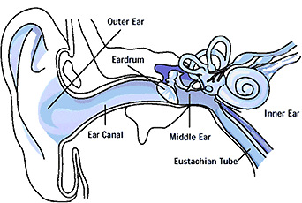
Tiny Hairs Live Here

Slide 5
To watch how your ear helps you hear, look at this short video clip.
www.youtube.com/watch?v=lioNIbtFxSY&feature=related

Slide 6
How loud is a ______?
Whisper
Conversation
Lawn Mower
Chain Saw
Ambulance
Gun Fire
Pig Squealing
Firecracker
30 decibels
60 decibels
90 decibels
110 decibels
120 decibels
125 decibels
130 decibels
150 decibels

Slide 7
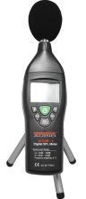
How loud is too loud?
Sounds are measured in decibels.
The range of decibels is from 0-194.
The safe range for hearing is anywhere under 85 decibels.
Decibels can be read using a sound or decibel reader such as this.

Slide 8
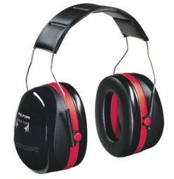
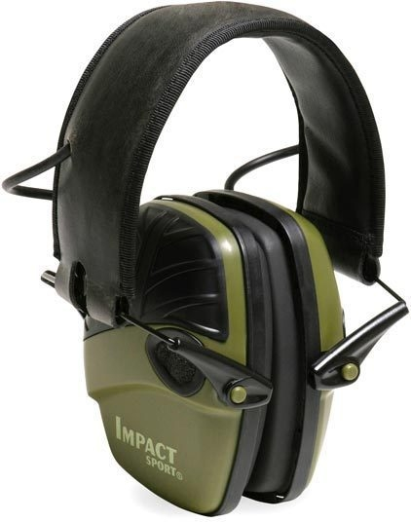
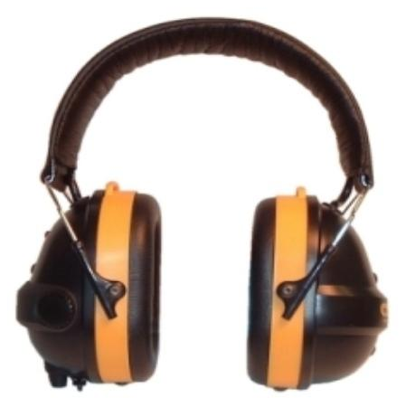
Ear Protection Gear
Noise Canceling Earmuffs:
Reduce sounds 20-26 decibels.

Slide 9
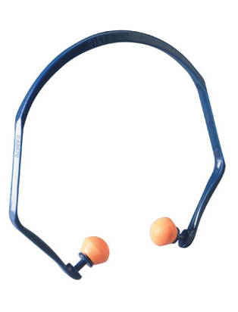
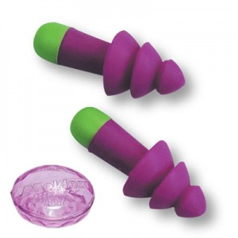
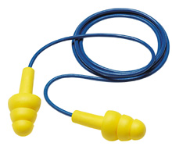
Ear Protection Gear
Reusable Ear Plugs:
Reduce sounds 23-30 decibels.

Slide 10
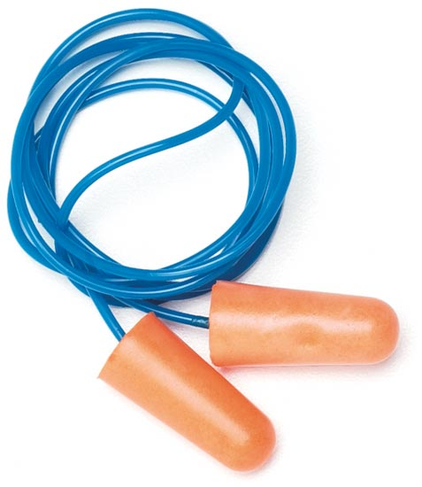
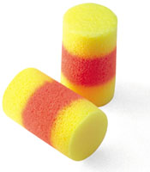
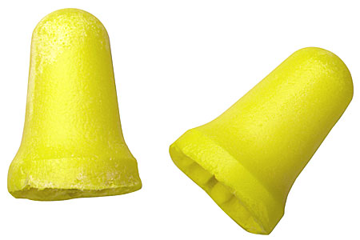
Ear Protection Gear
Disposable Ear Plugs:
Reduce sounds 24-33 decibels.

Slide 11
Let’s see what you’ve learned!

Slide 12
What decibel level is in the danger range?
a.) 25
b.) 103
c.) 62

Slide 13
What activity requires ear protection gear?
a.) Using a grinder
b.) Talking to a friend
c.) Feeding cows

Slide 14
Many agricultural workers develop hearing loss from working around farm equipment by what age?
a.) 75
b.) 4
c.) 17

Slide 15
Which of the following is a type of ear protection gear?
a.) noise canceling earmuffs
b.) reusable ear plugs
c.) disposable ear plugs
d.) all of the above

Slide 16
Keeping your hearing is your choice!
Protect the gift!!

Slide 17

Brought to you by:
www.kfb.org

